Slide 1

Business Intelligence
June 2019

Slide 2


Executive Summary
BI is modernizing and Aetna needs an overall strategy to support the business’ ability to foster better decision making and improved business outcomes.
Problem
Findings
Recommendations
Need a Business Intelligence framework that supports traditional reporting, on-demand decision support, and agile, flexible self-service analytics for business and power users
Enable easy access to analytical data stores, data preparation and prototyping capabilities.
Ensure we keep information protected and governed.
Business teams are creating their own BI applications resulting in line of business silos of data and insight.
Multiple data models exist across the lines of business resulting in inconsistent rendering of common information
Limited analytics governance exists.
Two BI/Analytics Centers of Excellence exist with limited resources
Implement a business intelligence framework that helps business select the right tools based on their needs.
Establish centralized BI Center of Excellence to guide business, provide best practices and promote best-in-class technologies.
Invest in a BI semantic layer and data catalog to support business in locating, accessing and rendering data.

Slide 3

Business Opportunity
The business is looking to use a data-driven, evidence-based approach for decisions making, innovation and transformation
Opportunity Statement
Overview
By modernizing our Business Intelligence framework, we have an opportunity to give business access to a diverse set of analytic capabilities and data in a governed and secure way that helps them quickly uncover new insights, recommend actions and help make business decisions.
Engagement:
Self-service analytics empowers users to extract value from data
Business Operations:
Agile and fast analytical reporting leads to better, more timely business decisions
Insights:
Actionable insight cannot be created without easy access to integrated data

Slide 4
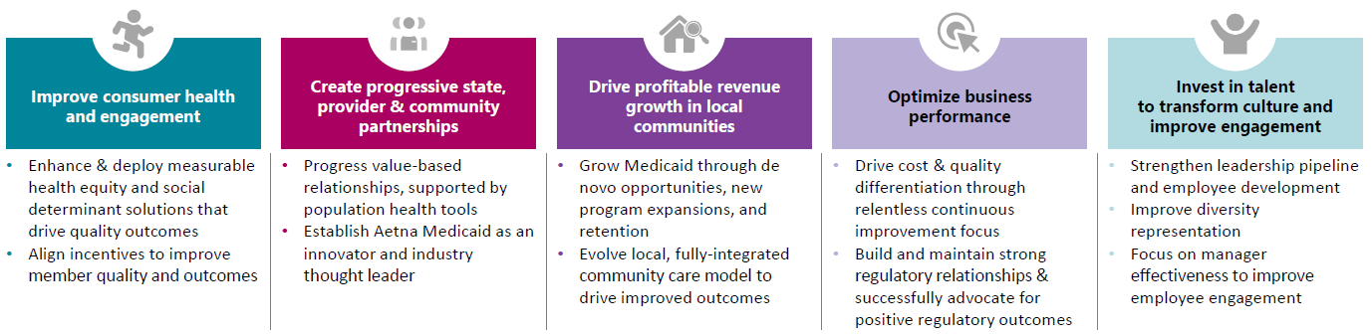
Why is it Important to Aetna?
A modernized BI environment through a unified approach will provide answers to business questions quickly and reliable.
Mission Statement
Create a modernized BI Platform that helps Aetna uncover the insights to improve how we interact with our partners and people we serve
By understanding the member before they call
Anticipating the needs of our providers
Uncover new ways to grow business
Consistent performance business across lines of business
Uncover talent gaps and improvement programs
How We Differentiate
“You Don’t Join Us, We Join You” in this transformational journey to health and wellness

Slide 5
Where are we today?
Currently, Aetna’s BI environment is separated by business silos with hidden costs, no BI tooling standards, and limited program management and metrics.
Current Business Intelligence Tooling
Tableau
Power BI
SAP Business Objects
Excel
Reporting Layer
Reporting Layer
Reporting Layer
Reporting Layer
Analytics Layer
Data Prep
Analytics Layer
Data Prep
Analytics Layer
Data Prep
Analytics Layer
Data Prep
Dimensional Semantic Layer
Dimensional Semantic Layer
Dimensional Semantic Layer
Data Management
Data Management
Data Management
Netezza
Data
Lake
Data
Warehouse
files

Slide 6
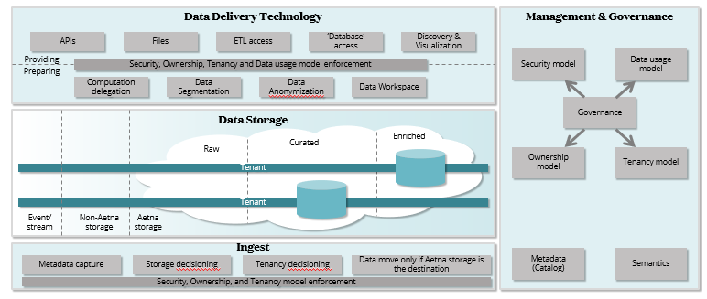

In Flight Investments
There are some initiatives which are helping to drive Aetna’s BI capabilities forward but we believe there is significant room to grow
BI COE
1
2
Tableau
78 Server sites, 814 Desktop Licenses, 16,605 Server Users
Evaluation of new Analytics tools
Microsoft Power BI
SQL Server BI Platform
SAP BO & Crystal Reports
Current Activities and Initiatives
Analytics/BI COE
BI COE
Analytics COE
Unified Data Fabric
Health Cloud
1
2
3
3
4
4

Slide 7

Conceptual Model – Data and Analytics Landscape
The data and analytics landscape is multi-dimensional with very different classes of use cases and with the need to provide cohesive insight across analytics platforms
Insights AppDev Platform
Should data be shared globally in a unified fashion?
Wide range of Analytics
Packaged Analytical Solutions
Business Critical and Mission Critical
Programmatic and Exploratory
Integration and Transformation
Existing Services and New Services
Direct and Indirect Monetization
Business
Analytics
Advanced
Analytics
Unified
Data
Fabric
Business
Intelligence
Data
Science
Key question to ask
Notes:
Explicitly decide what data will be shared
Business analytics includes operational reporting
Business intelligence is typically delivered through BI tools
Data science is exploratory in nature and people heavy, aimed at finding opportunities for insight
Advanced analytical codifies derived insight and delivers in actionable form (Next Best Action is an example)
Unified Data Fabric also used for non-analytical use cases such as historical information for business platform integration (example is the Aetna Clinical Platform program)
Data monetization is a separate concern on top of analytical capabilities, can happen through the delivery of packaged analytical solutions or insight development platforms
Business critical is to optimization the way the business operates, mission critical is to optimize the Health Consumer experience – both are necessary

Slide 8
What does Success look like?
In an ideal future state, Aetna would provide an agile and flexible BI framework that support self-service analytics to support actionable insight
Engagement
Business Operations
Insights
To…
To…
To…
Self-service Analytics
Agile and flexible
Data available to answer questions
From…
From…
From…
Waiting on IT
Siloed & Complex
Difficult to find, , low trust
Where we want to go
Self Service Analytics
Support a full range of analytic workflow capabilities and use cases
Requiring little involvement from IT to predefine data models
Unified Data Fabric
Utilize the unified data fabric to consume data for analytics
Trusted source with consistent results
Shared Semantic Model
All data is described in business terms, managed and secured
UDF sources the analytical data stores
Easy access to data
Support the ability to locate data and understand data context
Be able to create and publish reports quickly
360 Profile
Connected data across the enterprise to obtain a unified view of a constituent
Support next best action to improve member engagement
Cataloged Data
Business user is able to use data catalog to find data needed
Access data almost immediately and use

Slide 9
What does Success look like?
In an ideal future state, Aetna would support and upgrade the selected best in class BI tools, provide a data catalog and a common semantic layer to find, access and understand data
BI Tool
BI Tool
BI Tool
Reporting Layer
Reporting Layer
Reporting Layer
Analytics Layer
Data Prep
Analytics Layer
Data Prep
Analytics Layer
Data Prep
Data Catalog
Common BI Semantic Layer
Analytical Data Management
Sandbox
Analytical Data
Analytical
Data
delivery
Unified Data Fabric

Slide 10
Necessary Actions
Based on the results of this analysis we are recommending the creation of a unified Business Intelligence framework that supports traditional reporting, on-demand decision support, and agile self service analytics for business and power users
Capability Area
In Scope Capabilities
Necessary Actions
BI tools
Analytic Data Mgmt.
Select tooling to support semantic interface that supports Aetna’s BI tools
Determine approach for selecting and positioning enterprise data wrangling tools
Enable all features on Aetna’s BI tools that add high value analytic capabilities
Establish a single Center of Excellence that owns the success of BI, keeping tools current, and monitoring progress
Insights
Monitoring & Mgmt
BI Semantic layer
Unified Data Fabric
Define data delivery patterns for BI Framework to access analytical data in UDF
Establish a data catalog to publish details on data that allows business to easily find data.
Define common enterprise data models that enable coherent rendering of insights across common subject areas
Data Catalog
Data Delivery

Slide 11

Next Steps
To continue proving a best in class BI framework, additional time and investment to enhance our current environment is needed
Near-Term Action | Long-Term Action
Identify and apply BI semantic layer tools (CHS and O-CTO) Fully implement our current BI Tools (TBD) Determine approach for selecting and positioning enterprise data wrangling tools (O-CTO) Implement a Centralized BI and Analytics CoE (TBD) | Build semantic models of business analytic subject areas (Business) Finance Member 360 Clinical Determine Data Catalog strategy and tooling (O-CTO and CHS) Put in place a Monitoring & management process (TBD)

Slide 12
Appendix

Slide 13

Turning vision
into action.

